Slide 1
UNICON 19 World Unicycling Championships
Seoul, Korea
26th July ~ 6th August 2018
Notes:
Hi, Everyone
Im Kyungsoo Kim, the president of Korea Unicylcling Ferderation, I am happy to host the next Unicon 19. Absulutely my mebers all love to do that.

Slide 2
1.1 Location - Korea
South Korea
Notes:
Korea is located at Asia east , between China and Japan. But you could find it very quickly.

Slide 3
1.2 Airport to unicon(70km) (Seoul national university science)
Notes:
It is about 70km from Incheon international airport to Seoul National University of Science. It takes 1hour by limousine if there is no traffic jam.
Also you could take the subway. About limousine: 05:40~22:50(from ICN) 4:40~21:00(to ICN) every 15~30minutes. Subway:

Slide 4
1.3 Kimpo Airpot to Unicon(37km) (Seoul national university science)

Slide 5
2.1 – Seoul National University of Science
Gym 2
Accommodation
Track
Gym 1
Notes:
All place for competition is very close and they are in the University and also the restaurant is in
campus.
We will accommodate 1,600 person during Unicon 19 in a university campus

Slide 6
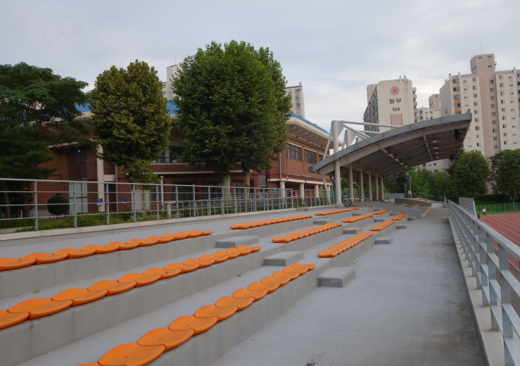
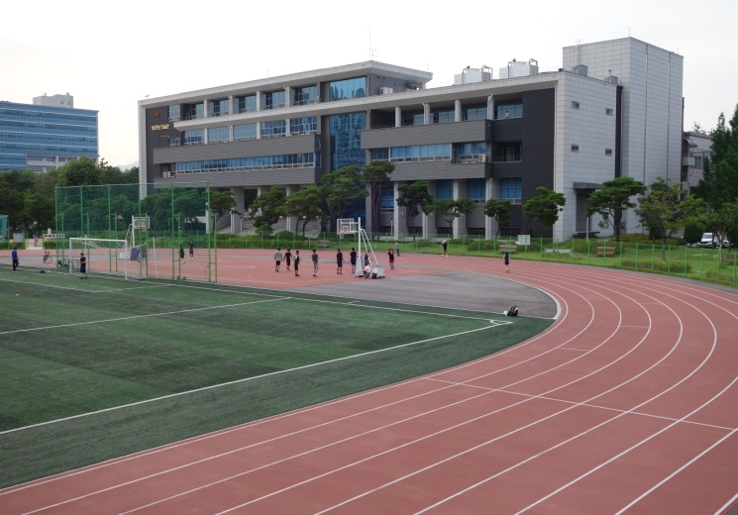
2.2 – Seoul National University of Science
Notes:
Gym is next to the track. So it is very convenient

Slide 7
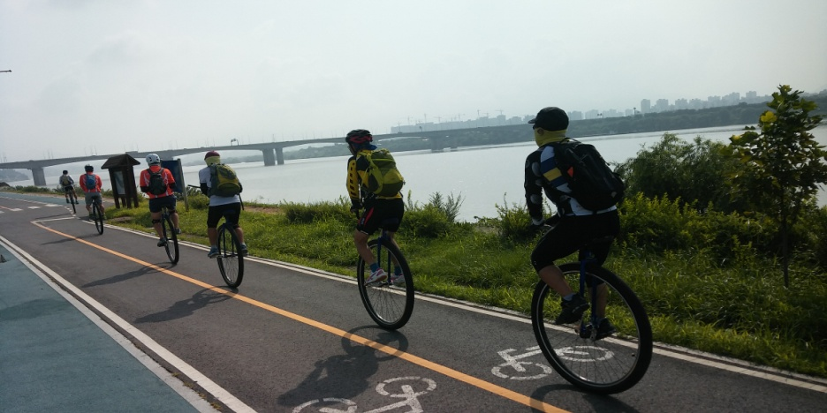
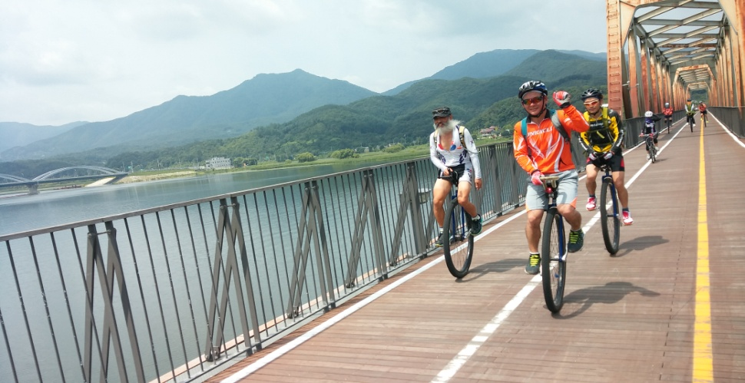
3.1 Road Race
Notes:
Han River, Junglang Stream is colse to have a race for 10k, marathon, 100k, from Seoul national university of Science.

Slide 8
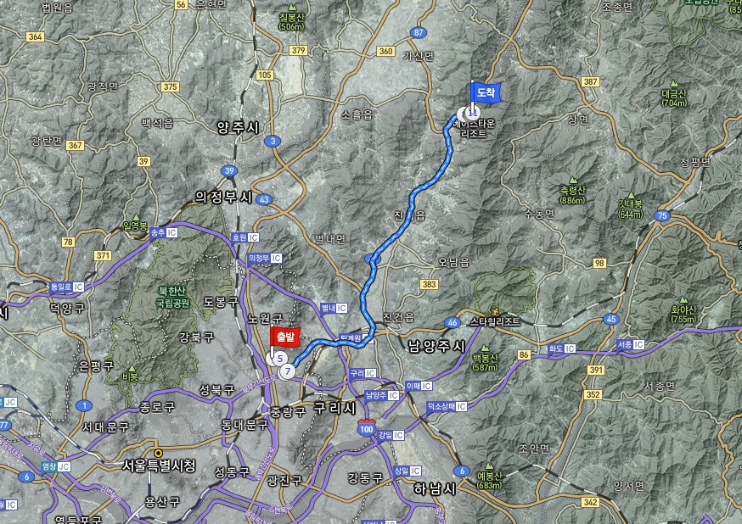
3.2 Muni
Notes:
It is 31kms to resort for muni.

Slide 9
4.1 Sightseeings
Notes:
The palace of Choseon Dynasty. Especially night view is wonderful.

Slide 10
4.2 Sightseeings

Slide 11
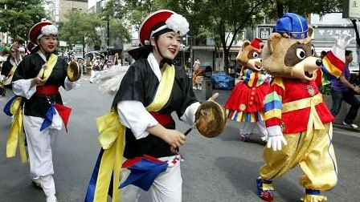
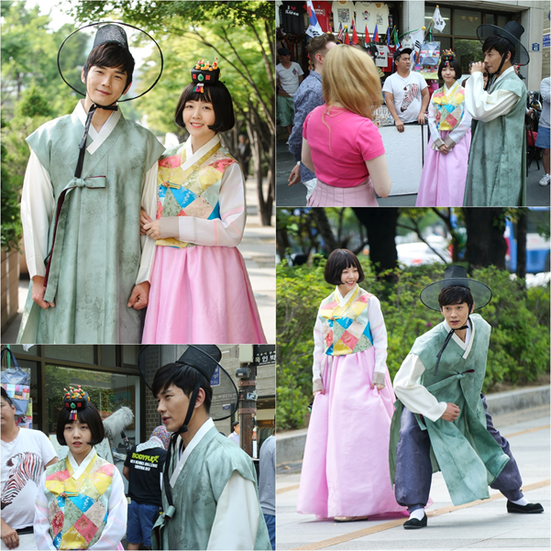
4.3 Sightseeings
Notes:
Crouise on Han River and traditional street Insadong

Slide 12
5.1 Foods

Slide 13
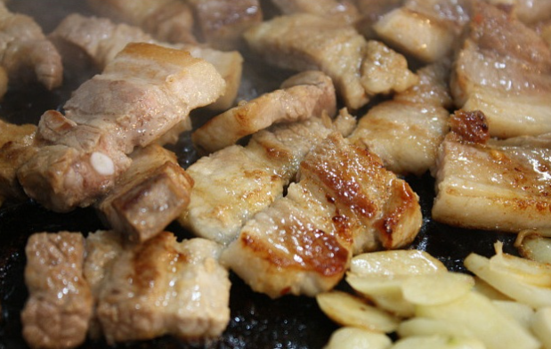
5.2 Foods

Slide 14
5.3 Foods

Slide 15
See You Next the Unicon 19

